Slide 1
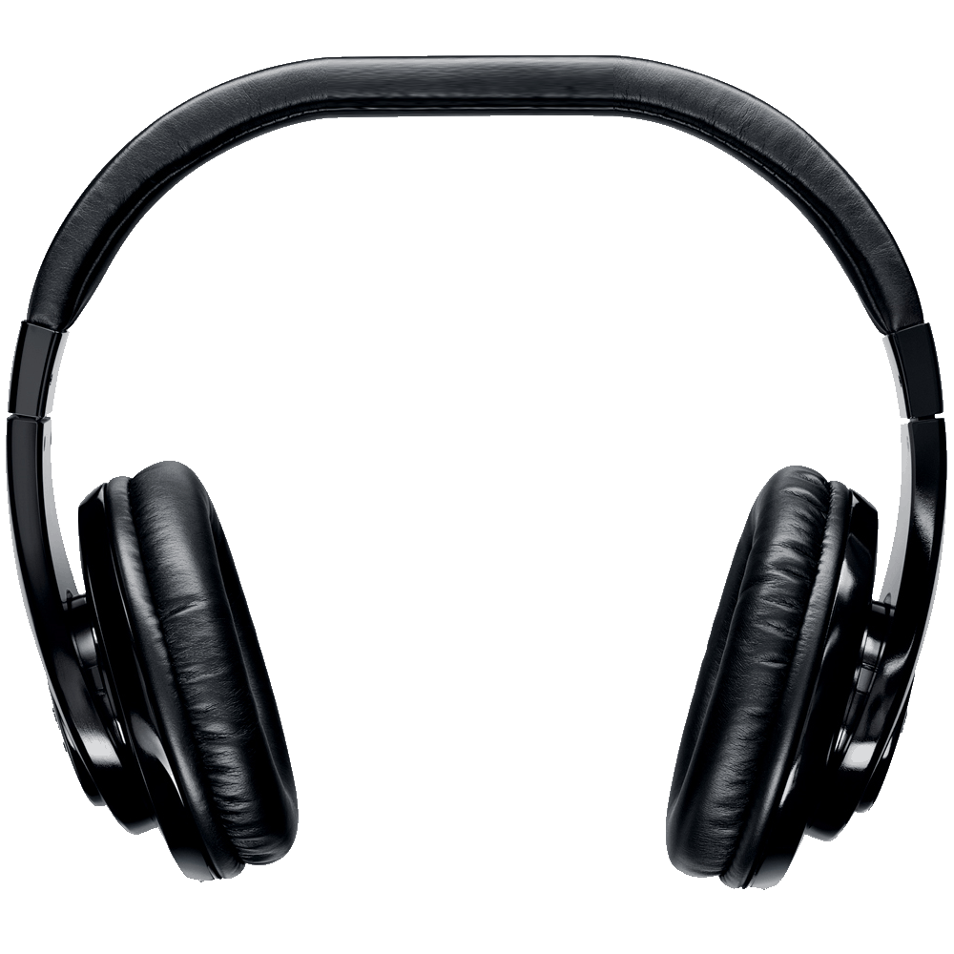
Team MIDI-PoP
Zach Boehm
Andy Ybarra
Brehon Humphrey
Ryan Tenorio
Kyle Mylonakis
Jonathan Sun
Notes:
In our project for SS12 we built an applet that helps solve the problem of concert hall seating and the variations in sound that arise when sitting in a different seat.

Slide 2
“Audio Preview For Venues”
“Venues with assigned seating (i.e. concert halls) sometimes provide view simulations from a given seat to allow customers to determine which seat they’d like to buy a ticket for. However, for a person with a visual disability, the more useful information is how the venue sounds at that location.”
“Develop a system that models the acoustics of a given venue and lets users hear how a clip will sound from a given seat.”
Notes:
This is especially important for visually disabled people, who may care especially about the subtle differences in sound in a venue more than the view. Musicians and people with a trained ear also place great importance on getting seats with great acoustics, not just visuals.

Slide 3
MIDI-PoP Team Members
Ryan Tenorio, MIDI Master
Kyle Mylonakis, Acoustic Consigliere
Brehon Humphrey, Amateur Actor
Zach Boehm, Button Extraordinaire
Andy Ybarra, Applet Maharishi
Jonathan Sun, Vector Visionary
Notes:
Our team is composed of
Ryan Tenorio, who handled the sound mixing
Kyle Mylonakis, who advised us on auditorium acoustics and sound physics
Brehon Humphrey, who was called by a film crew halfway through the project as an extra
Zach Boehm and Andy Ybarra, who designed the user interface
Jonathan Sun, who coded the sound distortion algorithms

Slide 4
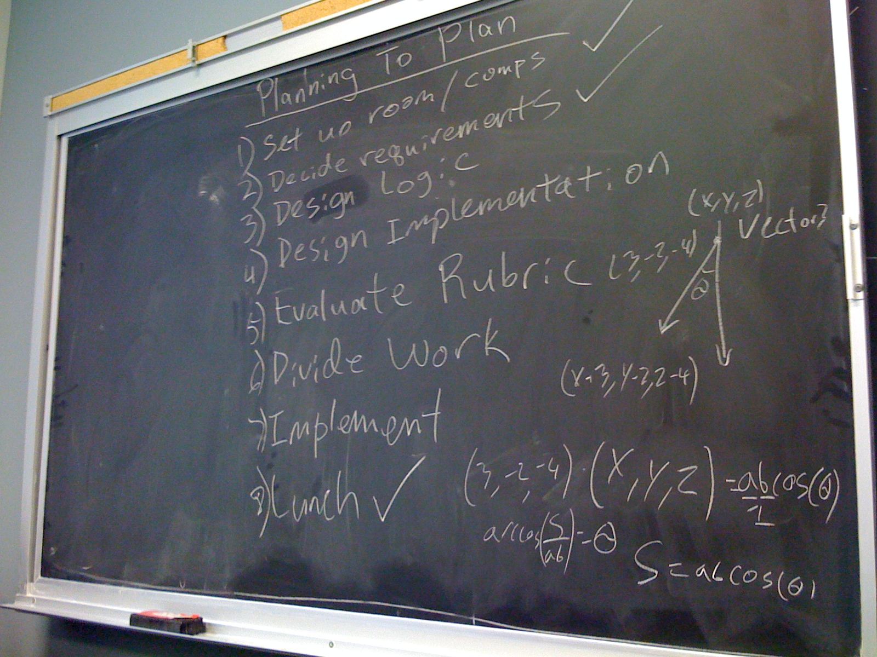
Planning To Plan
Notes:
We succeeded in this project because we took planning very seriously. The first thing we did was work out an overarching idea of how to approach the project. This included asking for clarifications about the scope of the project from admins.
We decided that since this was going to be a ticket purchase system, the best implementation would be a Java Applet that venues could display on their websites. To address the issues of visual disability, we implemented a voice system that would call out the names of seating sections and an arrow key moving system for the sections. At the press of a button, the user hears a preview of the orchestra at that particular seat. Actually buying the ticket is outside of the scope of this project and is handed off to the end user.

Slide 5
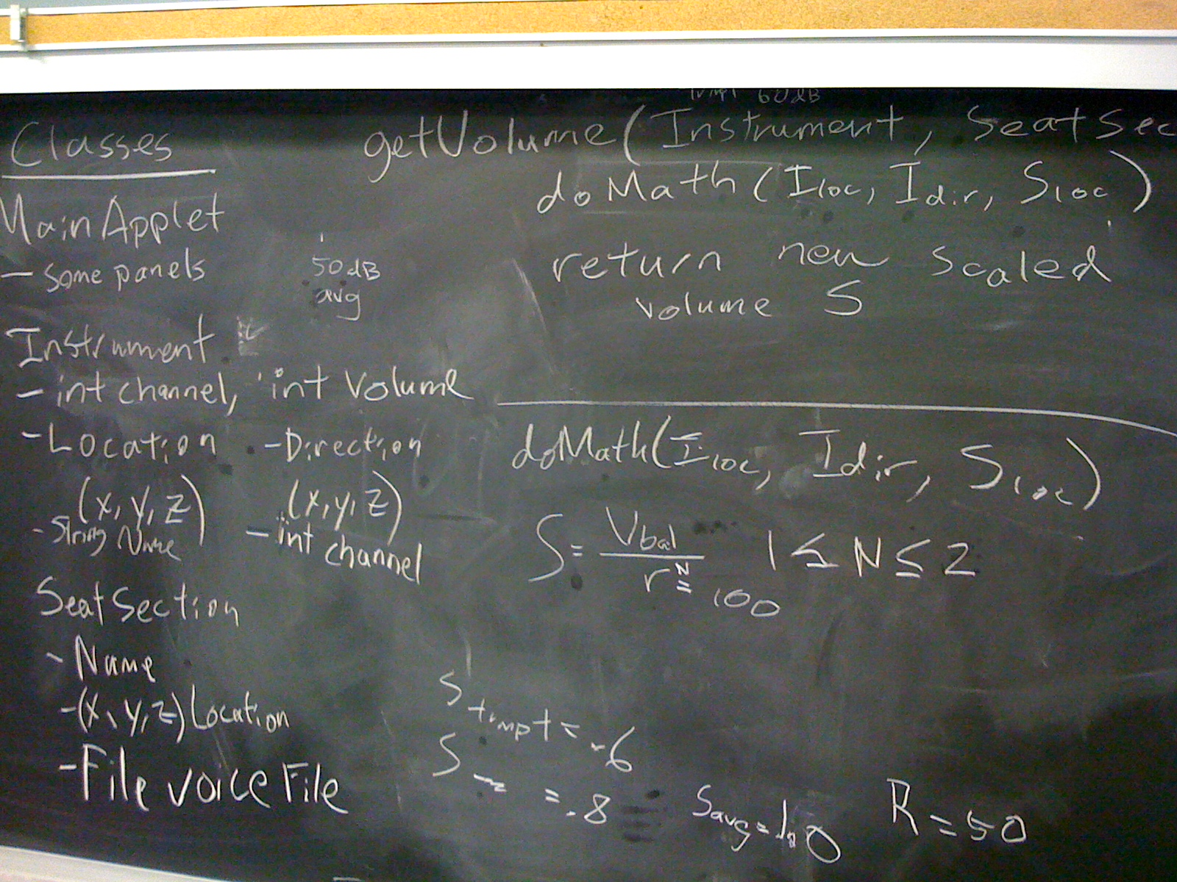
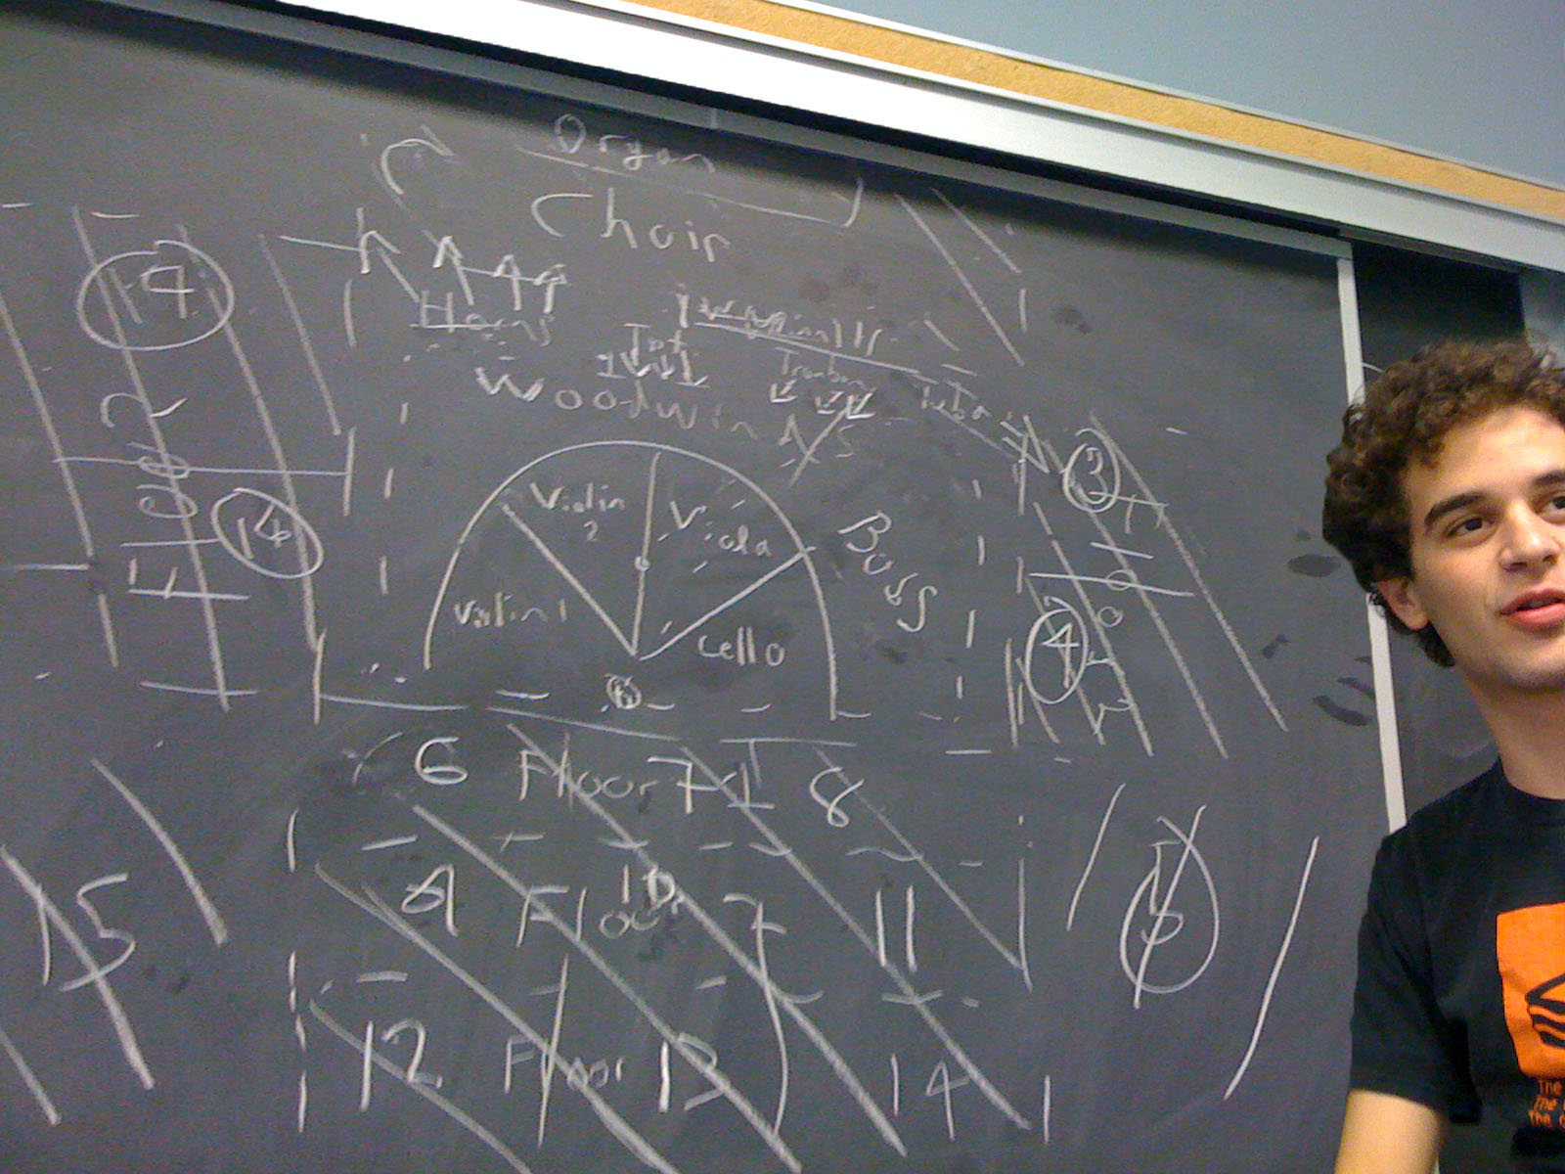
Blueprints
Notes:
Once we had an idea of what we needed, we laid out the general architecture of our program using the blackboard heavily. Kyle, a musician who frequents symphonies, pointed out the many factors to consider in seating as well as subtleties between individual instruments. To simplify our vector calculations, we divided instruments into ones with directional sound and ones without directional sound.
We modeled our test concert hall around the Disney Concert Hall in Los Angeles, which has a fairly standard layout, but our program can be configured to work with any venue and orchestral setup.

Slide 6
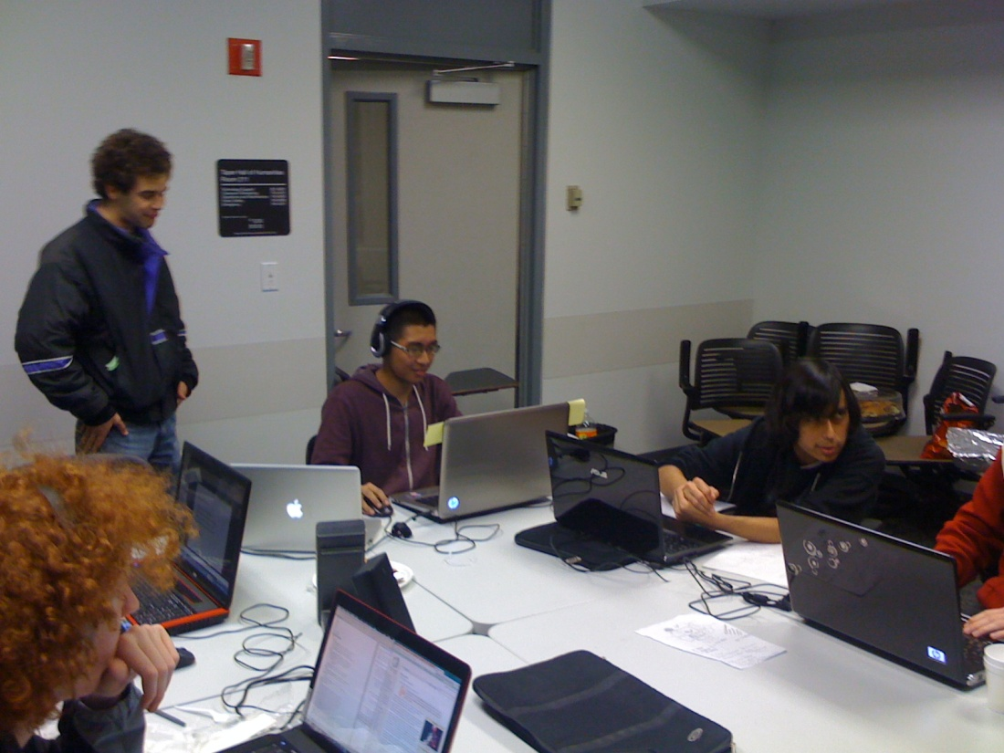
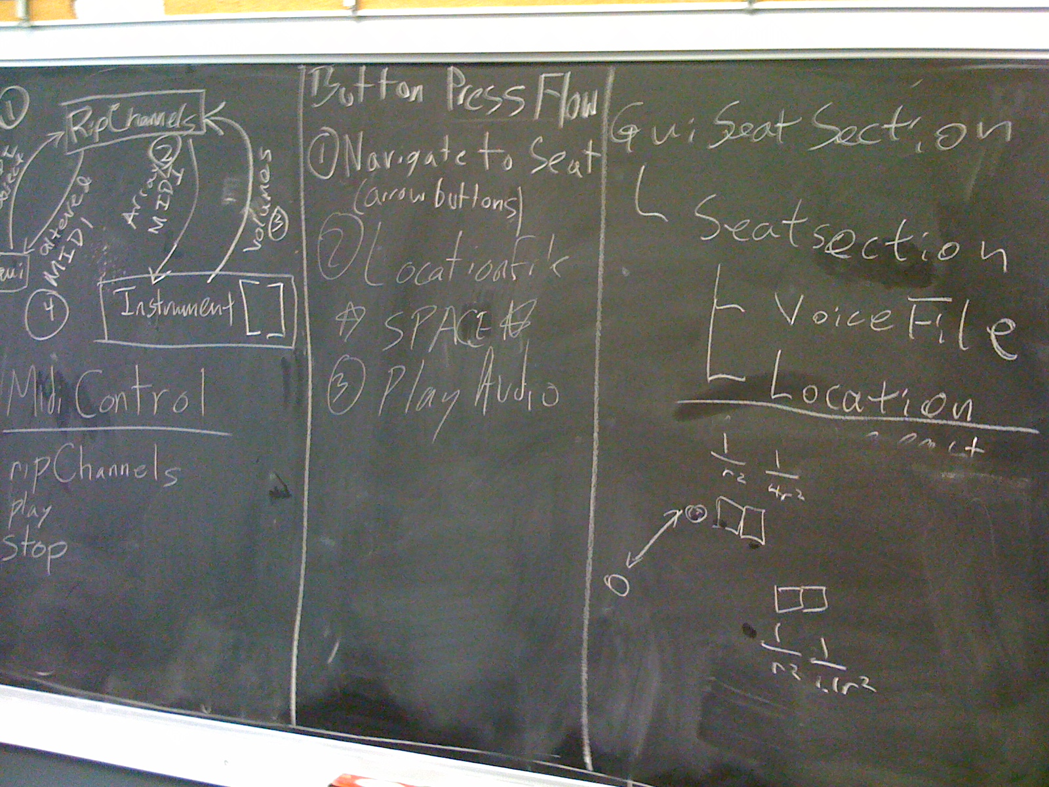
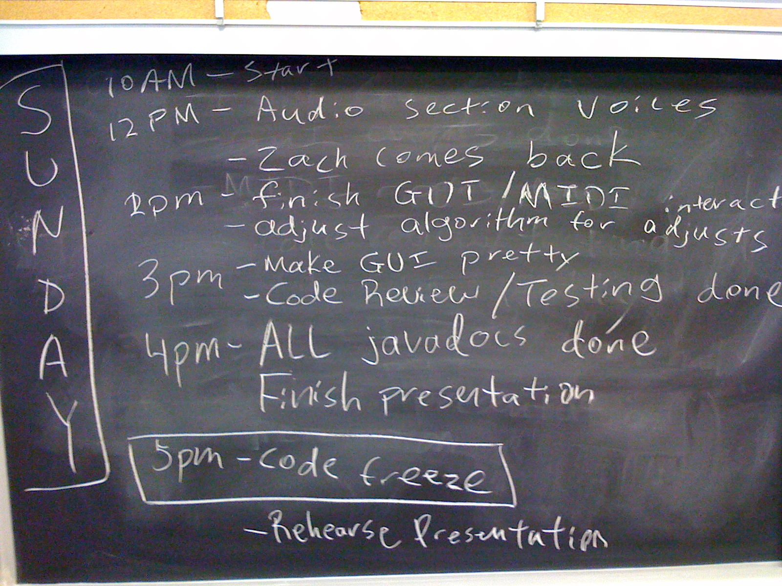
Division
Audio
GUI
Logic
Notes:
We designed our classes before rushing into coding. 2 people worked on the logic behind adjusting the instruments, 2 people worked on synthesizing the MIDI files, and 2 people worked on the GUI at all times. We never had file conflicts because nobody ever worked outside their class. Every day we had a schedule that kept us aware of the time and deadlines.

Slide 7
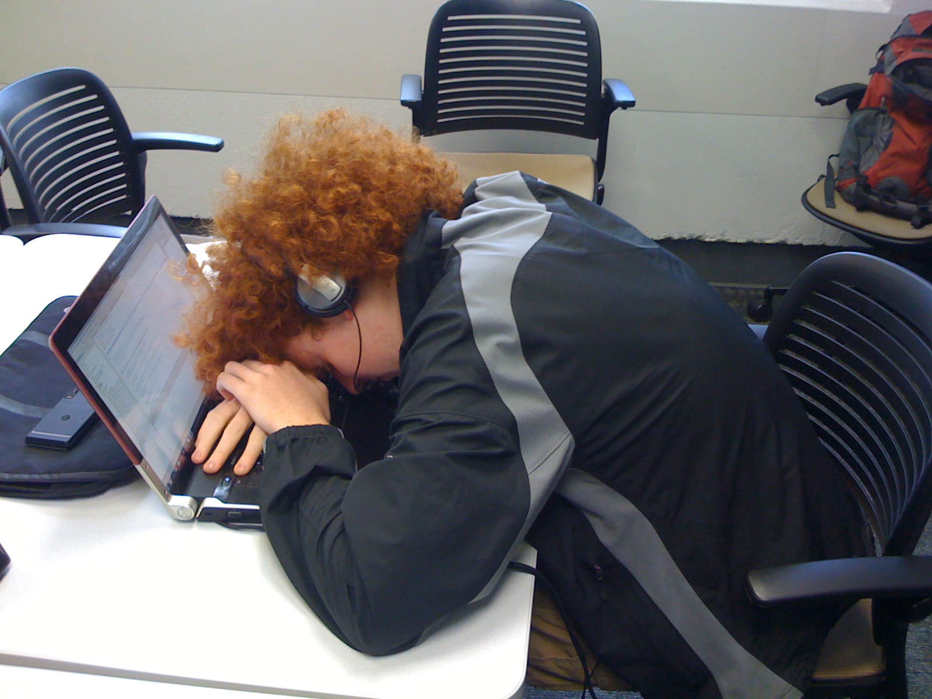
A Weekend of Coding Later…
Notes:
DEMO GOES HERE

Slide 8
“SS12_AudioPreview [trunk]”
Total man-hours: 100+
Total lines of code: 900+
Coded in Java using Subclipse/Tortoise SVN
http://code.google.com/p/ss12-usc-2011-audiopreview2/
High extendability
Notes:
Since our program is an applet, it can be embedded into any HTML page, like a ticketing site. This is part of our future plans.
Our code is highly extendable. Any venue can configure their seating arrangement and configure a MIDI file to be the sample. This makes it feasible as a real ticketing application. It is useful to people of all different visual disabilities because it has voice commands for blind people and a mouse interface for less disabled people. It is also very useful to musicians, conductors, architects, and venue owners.
Real-world MIDI samples are much more high quality than ours and can be very costly. We assume that venues would have access to these and could use whatever sample they want. We used the standard Java sampler because it provided a clean sound in which it was easy to hear subtle differences.

Slide 9
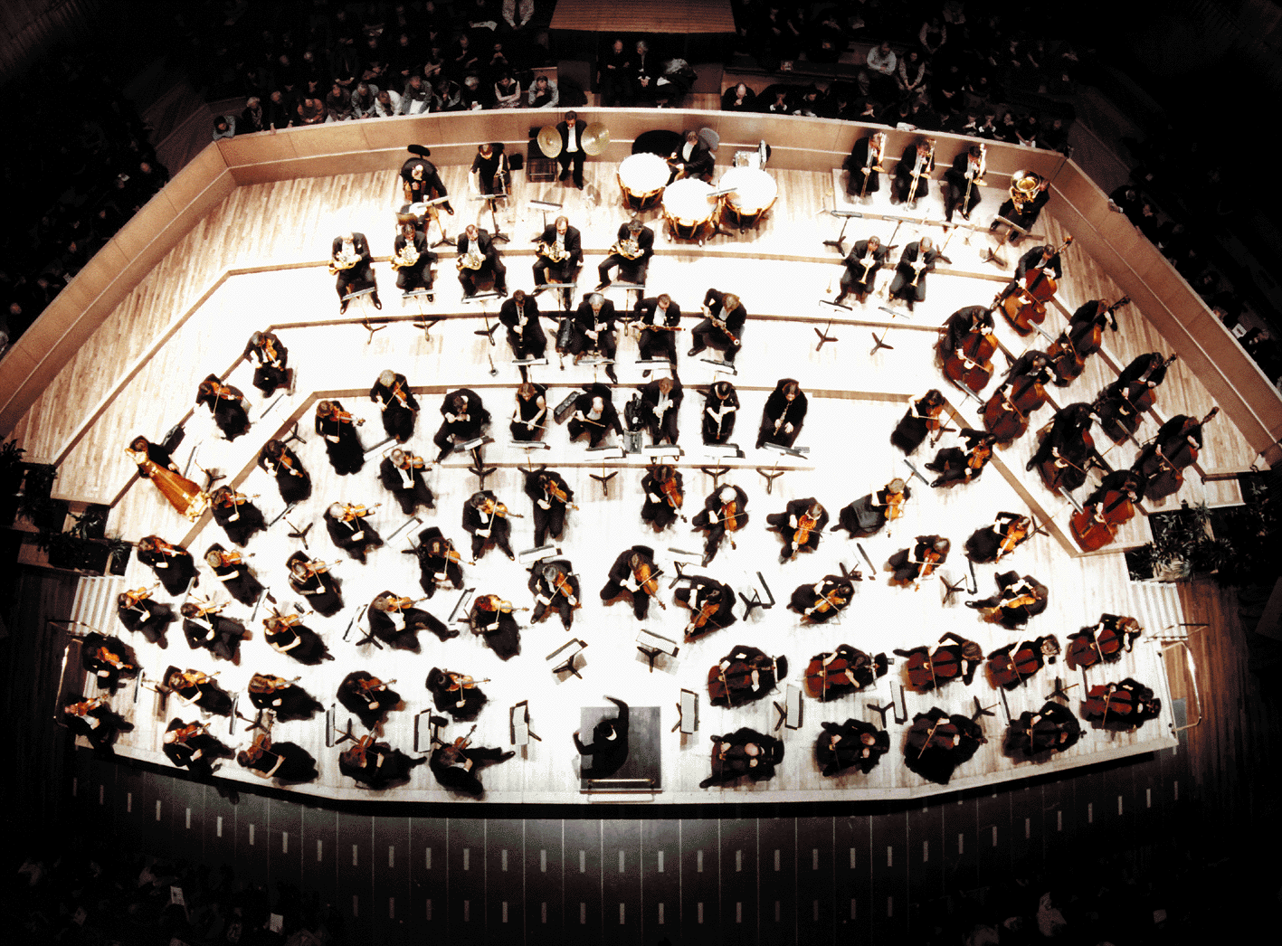
Questions/Comments?
Notes:
Questions?

Slide 10
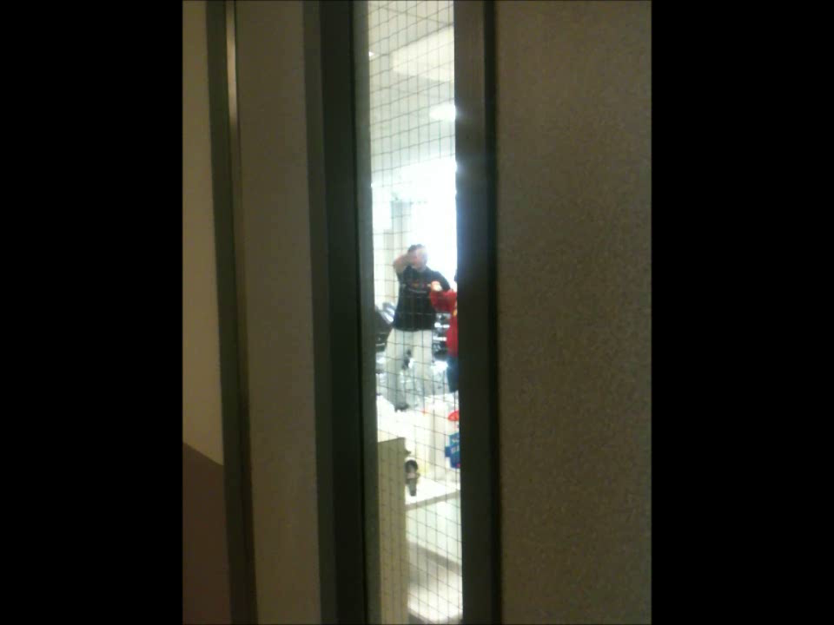
Special Thanks To:
ACM Officers
Judges
Mentors
Ben Walker
Project Possibility
Tanay Mehta→

